Slide 1
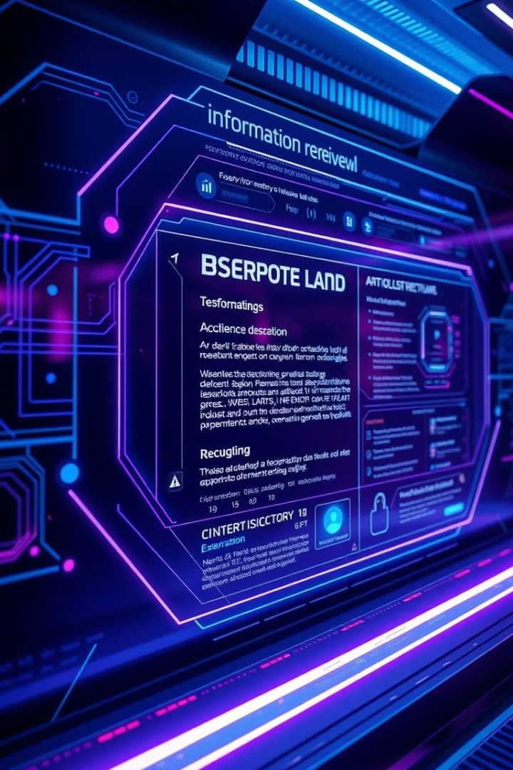
RAG in 2025: Intelligent Information at Your Fingertips
Unlocking Knowledge: RAG's transformative impact on information access.
A look into the advancements, applications, and future of Retrieval-Augmented Generation.

Slide 2
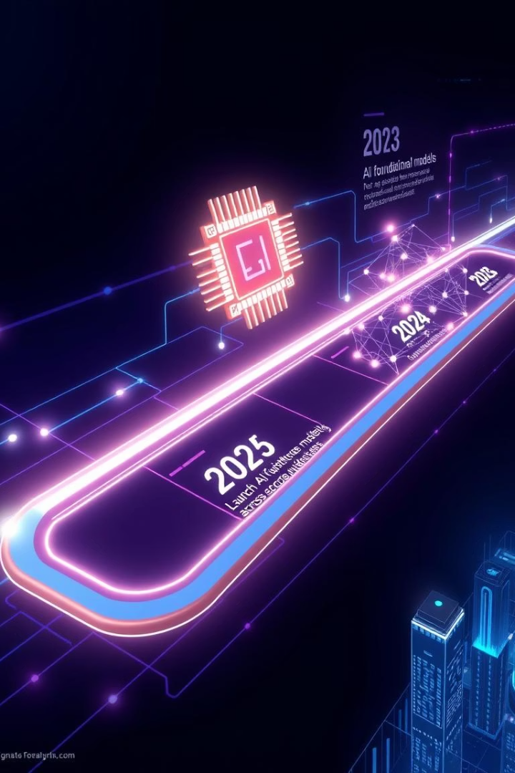
The Evolution of RAG (2023-2025)
Year
Accuracy
Latency
2023
75%
500ms
2024
85%
350ms
2025
93%
200ms
2023: Basic retrieval and generation models emerge.
2024: Advanced embeddings improve context handling.
2025: Self-improving, personalized, multimodal RAG systems.

Slide 3
Key Advancements in RAG Technology
Advanced Embedding Models
Contextual Understanding
Self-Improving Systems
Dynamic context windows handling long-range dependencies.
Reinforcement learning and knowledge graph automation.
Contextual embeddings using transformer networks like GPT-5.
Multimodal Integration
Personalized Retrieval
Combines text, images, audio, and video data for richer retrieval.
User profiling enables tailored information delivery.

Slide 4

RAG in Action: Use Cases Across Industries
Industry
Improvement
Example
Healthcare
95% accuracy
Mayo Clinic patient-specific treatments
Finance
30% risk reduction
Goldman Sachs real-time market analysis
Education
40% score improvement
Khan Academy adaptive learning paths
Legal
Efficiency boost
Contract analysis in seconds
Customer Service
Personalized recommendations
Retail company chatbot usage

Slide 5
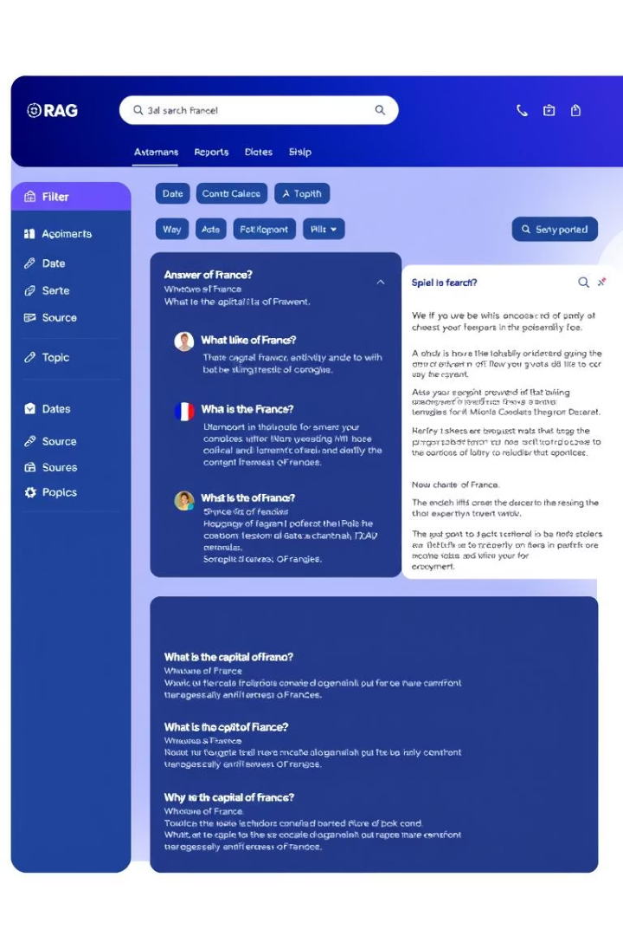
Visualizing RAG: Enhanced User Experience
Natural Language Queries
Visual & Auditory Integration
Users interact with systems using natural speech and text.
Incorporates images and sounds for richer responses.
Enhanced Knowledge Graphs
Interactive graphs display connected information intuitively.

Slide 6
Overcoming the Challenges of RAG
Data Quality
Explainability
Use high-quality, up-to-date knowledge bases for accuracy.
Provide transparent decision-making processes to users.
Bias Mitigation
Security
Apply fairness metrics and bias detection models.
Encrypt data and enforce multi-factor authentication.
Computational Cost
Optimize performance with GPUs, TPUs, and model compression.

Slide 7
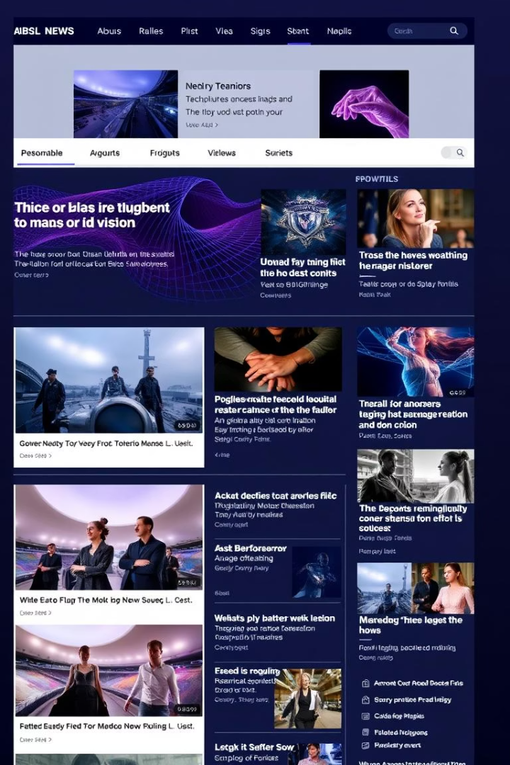
Case Study: RAG-Powered Personalized News Aggregator
1
Objective
2
Implementation
Deliver tailored news based on user preferences and events.
RAG retrieves relevant articles, summaries, and multimedia content.
3
Results
50% higher click-through rates and 4.8/5 user satisfaction rating.

Slide 8
The Future of RAG: 2025 and Beyond
Quantum Computing Integration
Enables faster retrieval and complex reasoning capabilities.
Decentralized Knowledge Networks
Ensures democratized and resilient information access.
AI-Driven Curation
Automated quality control for accurate and relevant knowledge.
Human-AI Collaboration
Seamless integration combining AI with human expertise.
RAG Agents
Autonomous systems capable of discovering new knowledge.

Slide 9
Ethical Considerations and Responsible AI
Transparency
Accountability
Fairness
Users should understand how RAG systems operate.
Clear responsibility for the outputs generated by RAG.
Mitigate biases and promote equitable outcomes for all.
Privacy
Security
Protect user data and maintain confidentiality.
Guard against misuse and data breaches with robust measures.

Slide 10
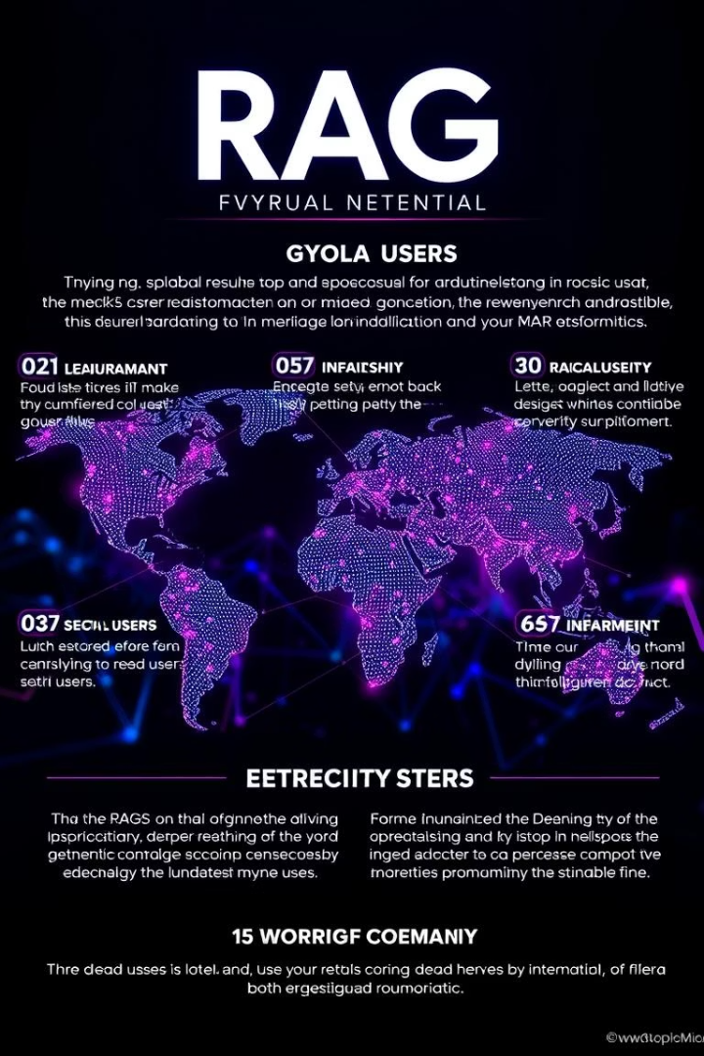
Conclusion: Embracing the RAG Revolution
RAG revolutionizes information access across industries.
Continuous innovation will unlock greater possibilities.
Ethical considerations are key for responsible deployment.
Q&A session to discuss your questions and insights.

